Slide 1

Project Launch (Hardware)
Ausdroid Club

Slide 2
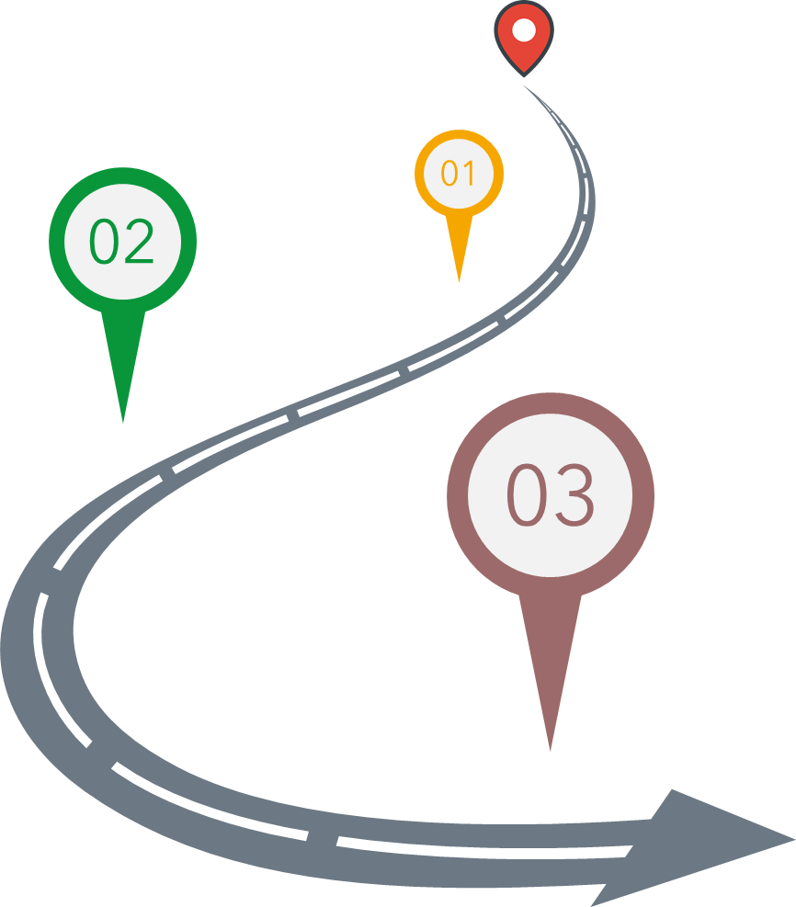




Welcome on board
You are here
Club Member
Junior Developer
Middle Developer
Senior Developer
Mini Test
Basic Task
Advanced Task

Slide 3
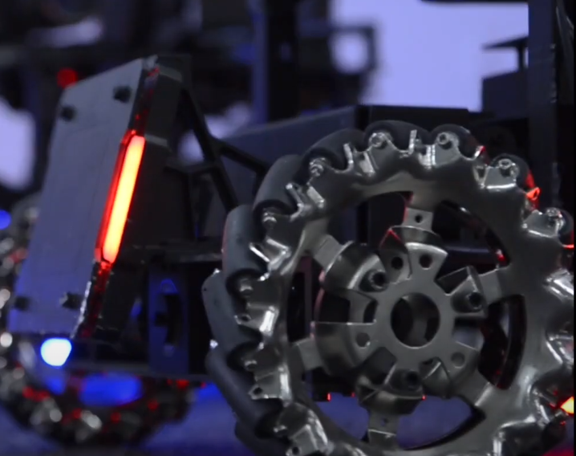
Hardware Development & Maintenance

Slide 4
Hardware Development & Maintenance: Overview
Projects:
  ME/EE design and development
  Embedded Programming
  Wireless Communication System
Potential Project:
  Robot Remodel

Slide 5
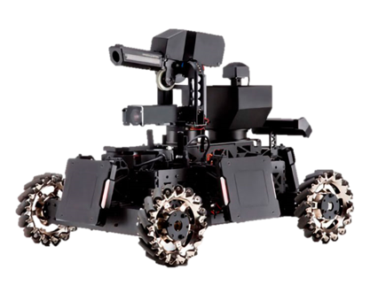
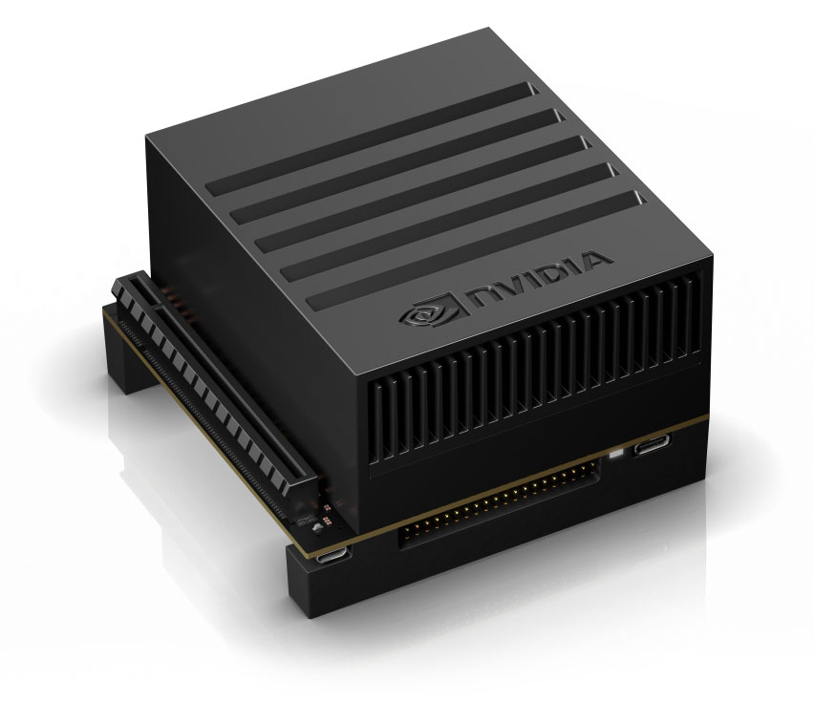
ME/EE Design and Development: Tasks
Xavier Installation
Outpost Camera Mounting Part

Slide 6
ME/EE Design and Development: Tasks
Xavier Installation
Outpost Camera Mounting Part

Slide 7
ME/EE design and development:
Project Outcome
Basic knowledge on omnidirectional wheeled robot
Basic knowledge on CAN, STM32, motors, etc
Design inspiration from an industry product

Slide 8
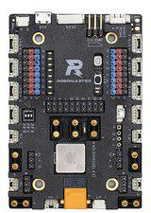
Embedded Programming: Tasks
Advanced Task
Develop the dodge function (chassis rotates quickly to avoid attacking while gimbal keeps stable to attack enemy).
Develop communication protocols for patrol and dodge functions to enable automatic control.

Slide 9
Embedded Programming: Project Outcome
Programming skill
Experience in development on one of the most popular microprocessor in commercial product! (not Arduino!)
Become our Senior Developer right away

Slide 10
Wireless Communication: Tasks
Basic Task
Setup a wireless communication system to connect two onboard computers (Xavier) and one computer out of the battlefield (the one with outpost camera).
Setup the antenna for the robot.
Setup wireless keyboard and mouse for the robot

Slide 11
Wireless Communication: Project Outcome
Basic knowledge on antenna
Basic knowledge on wireless communications

Slide 12
Hardware Development & Maintenance:
Key Information
Pre-requisite:
None
How to select this project?
An online mini test
Testing Time：
22nd August 2020

Slide 13
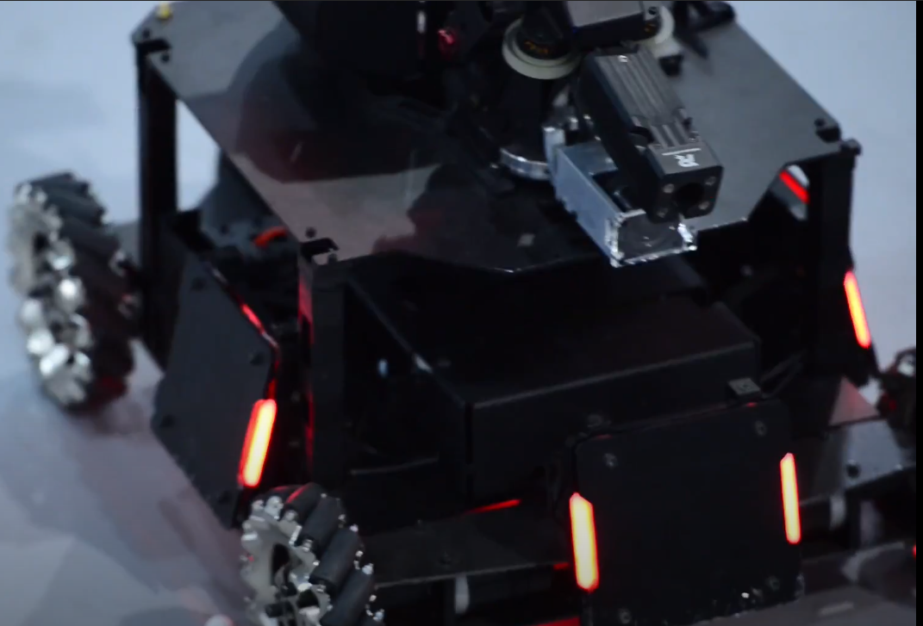
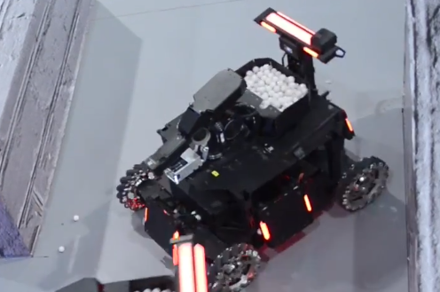
Robot Remodel

